Slide 1
Prototyping
Implementation of the ABC Using Modern Technology
Team: sdmay25-29
Client/Advisor: Dr. Alexander Stoytchev

Slide 2
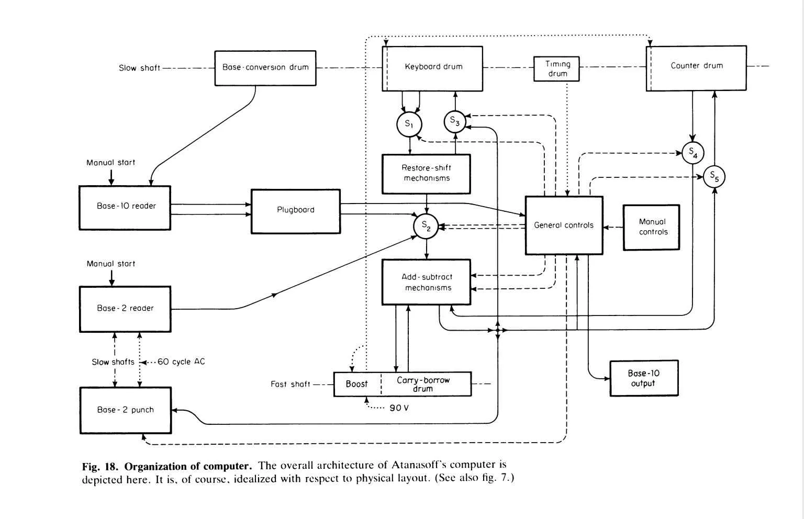
Project Overview
Implement the Atanasoff-Berry Computer using modern technology
The Atanasoff-Berry Computer (ABC) was the first electronic digital computer.
The purpose of the ABC computer was to solve systems of linear equations.
The ABC computer was constructed here at Iowa State.
The original ABC was destroyed in 1948.
We are recreating it as an educational demonstration of how it functioned.
The device that we make will be used as a learning aid to help teach students how computers function.
Block diagram representation of the ABC (Burks and Burks, 1989)

Slide 3
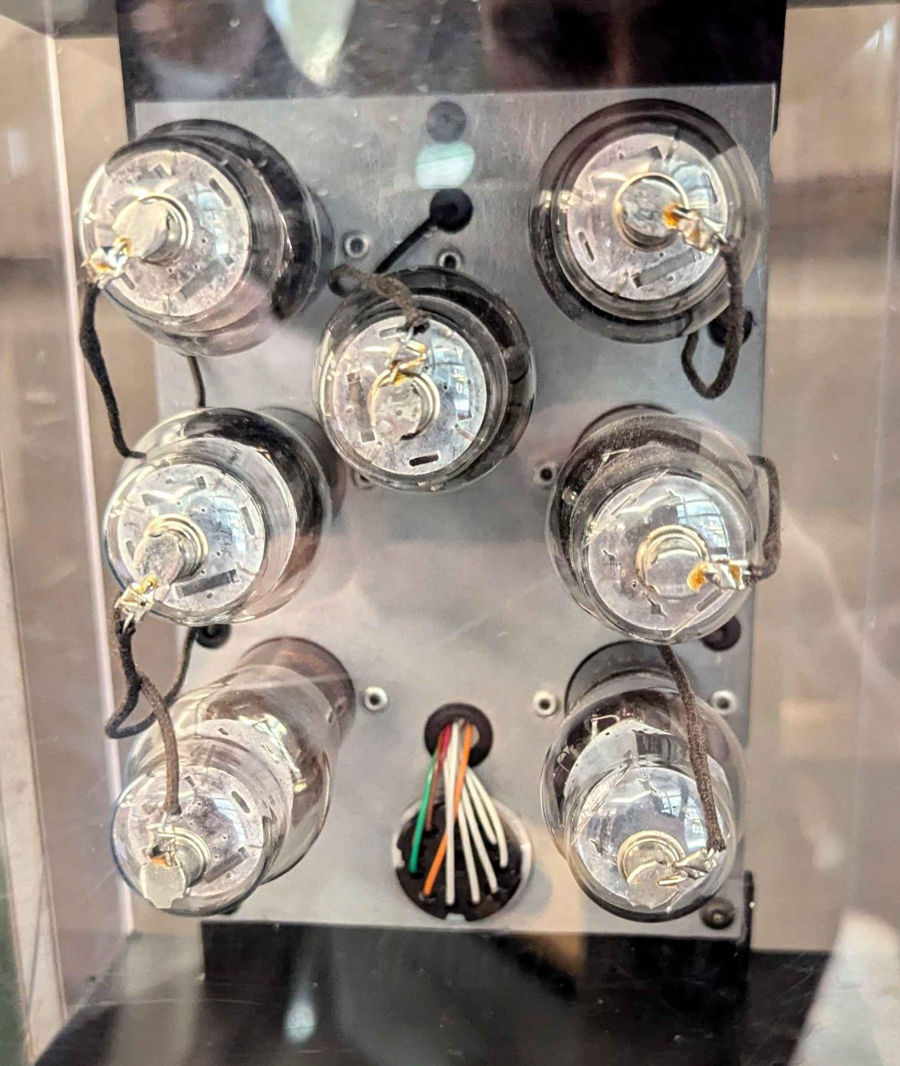
Adder-Subtractor Prototype
Purpose of this prototype is to test our design of the re-imagined adder-subtractor circuit
This is one of many standalone components that our project consists of
It happens to be the first component we have designed and prototyped
The goal of this prototype is to learn if our modern logic works identically to the original

Slide 4
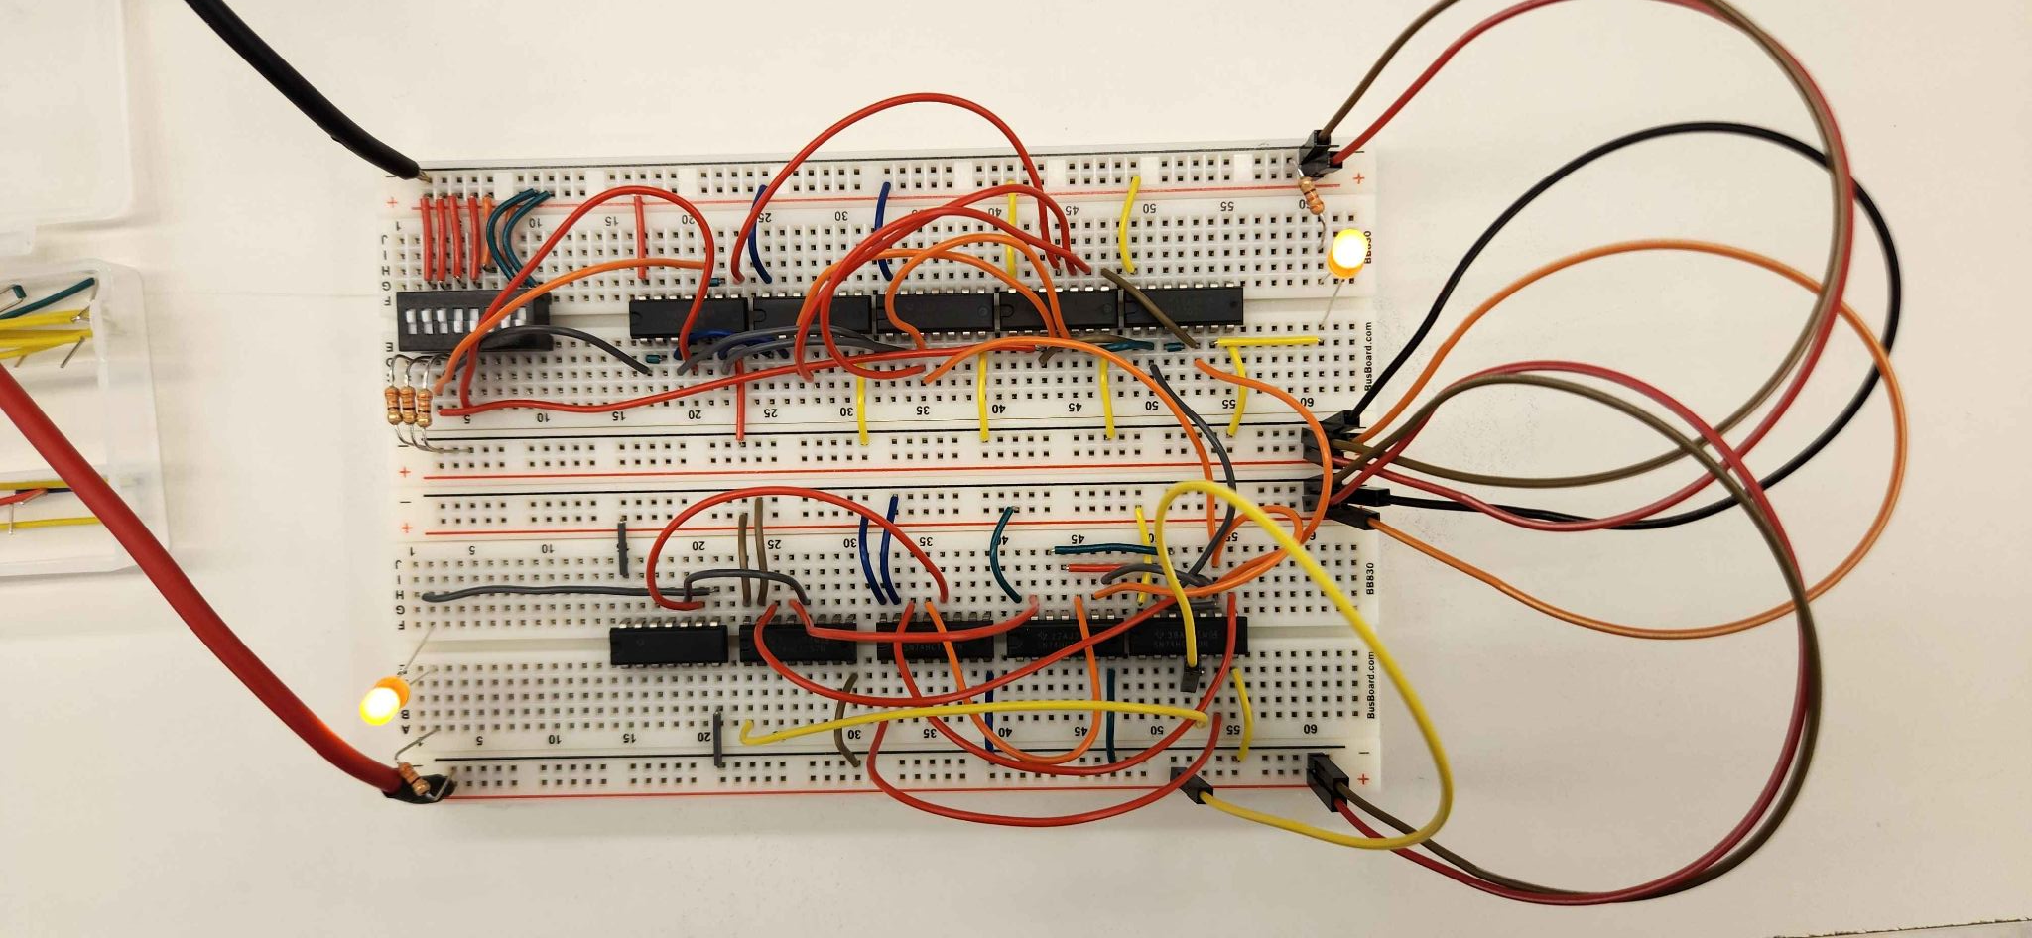
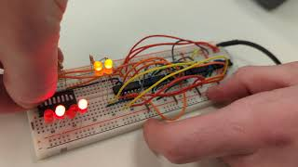
Demonstrate
Current prototype video: One breadboard, 5 ICs
First prototype: Double breadboard, 10 ICs

Slide 5
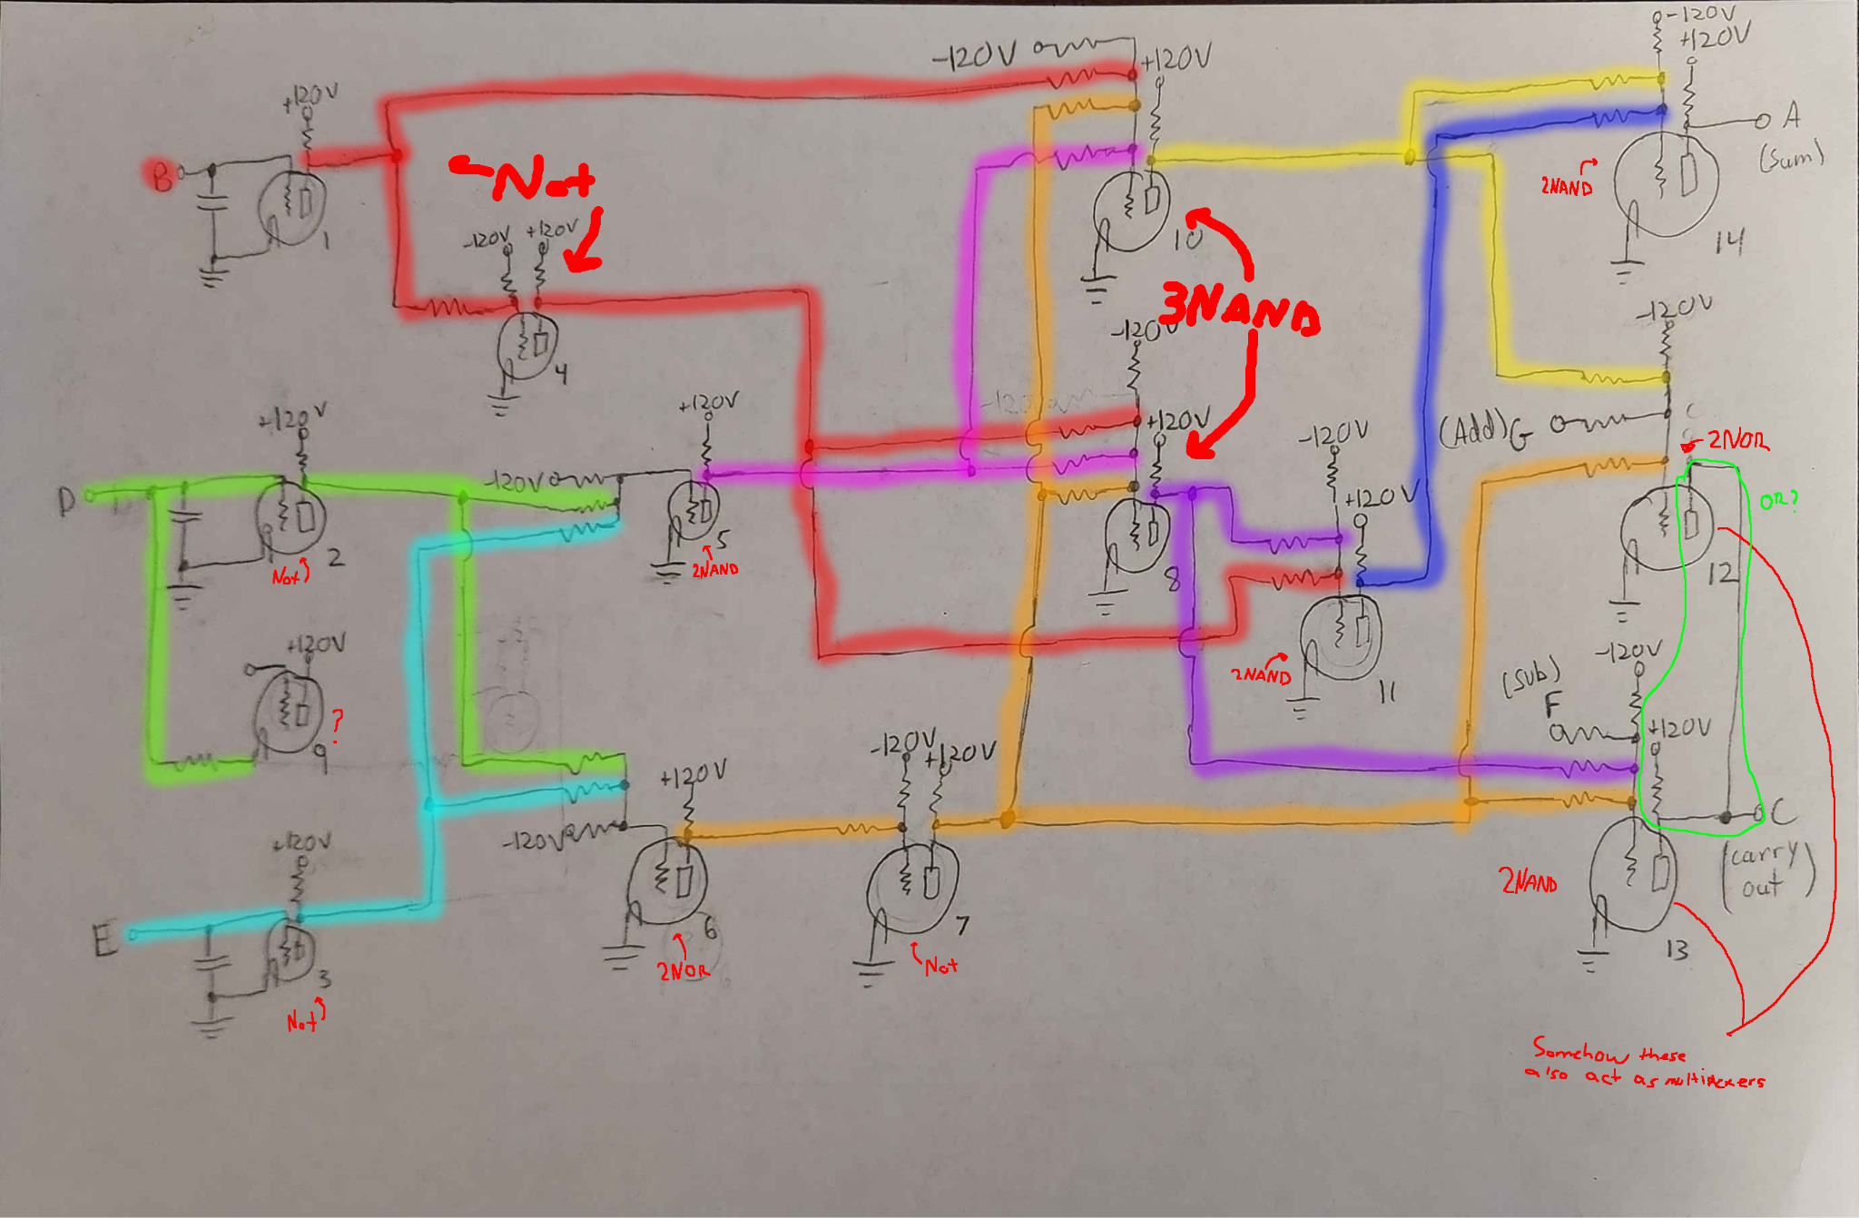
Reflect
Learned
We understood that the original diagram could be translated into modern logic gates
Worked
Atanasoff’s adder-circuit functioned properly
Didn’t
With the modern interpretation, its logic gate use was inefficient

Slide 6
Implications and Next Steps
Because of our prototype, we now know that our adder-subtractor design is fully functional
Our next step is to design and order a PCB that uses our adder-subtractor design (we have designed the PCB, just need to order)
We will continue to design and prototype the components of the ABC before ordering them on PCBs

